Slide 1
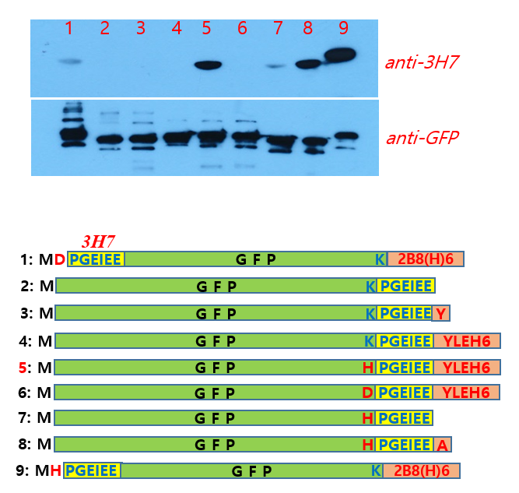
Anti-7AT tag antibody (BJA-002)
(mouse monoclonal IgG, 1mg/1ml)
Contact : BioJane (www.biojane.net)
010-5381-4677, information@biojane.net
BACKGROUND
7AT epitope sequence (HPGEIEE) is a modified epitope tag from a original of 3H7(PGEIEE) and is the part of Deinococcus radiodurans Bacteriophytochromes (DrBphP). This monoclonal anti-7AT antibody is highly specific to any protein containing minimal original epitope sequence (HPGEIEE). This antibody react better to a Alanine extended (HPGEIEEA) when tagged in the C-terminal end of the target protein than original tag (HPGEIEE)
Product research DATA
PRODUCT
Each vial contains 100 μg IgG (monoclonal) in 100 μl of PBS with <0.1% sodium azide, 30% glycerol
Specific to the peptide of HPGEIEE and HPGEIEEA in case of C-terminal tagging.
* Control protein:
purified 7AT tagged GFP protein (~28 kDa),
use 5~10 μl for western blot.
Specificity test of anti-7AT antibody to various constructs.
Western blotting(upper) analysis against GFP construct with various 7AT tags.. 7AT(HPGEIEE) tag is working in the N-terminus without extra amino acid, but extra Alanine is required when tagging in the C-terminus.
APPLICATIONS
Anti-7AT antibody is recommended for detection of HPGEIEE or HPGEIEEA peptide tagged fusion proteins by Western Blot, starting dilution with 1:5,000 (dilution range is 1:5,000~1:20,000), Immunoprecipition [~5 μg per 100-500 μg of total protein (1 ml of cell lysate)] and solid phase ELISA (starting dilution 1:1,000~1:10,000). Chromatine immunoprecipitation(ChIP)
SELECT PRODUCT CITAIONS
2. Kim TL, Cho MH, Sangsawang K, Bhoo SH (2016) Fine Mutational Analysis of 2B8 and 3H7 Tag Epitopes with Corresponding Specific Monoclonal Antibodies. Mol Cells. 39(6): 460-467.
3. Kim TL, Yoo J, Sangsawang K, Cho MH, Yang SH, Suh JW, Hahn TR, Bhoo SH (2014) Epitope mapping of monoclonal antibodies for the Deinococcus radiodurans bacteriophytochome. Protein Sci. 23(6): 812-818.
STORAGE
Store at -20℃. Stable up to two year from the date of shipment. Non-hazardous. No MSDS required.

