Slide 1
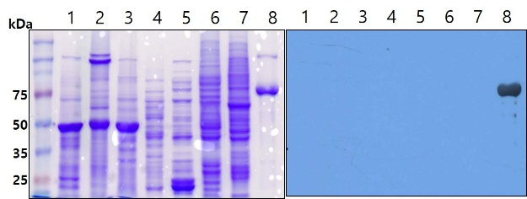
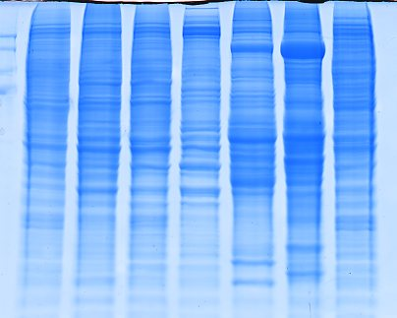
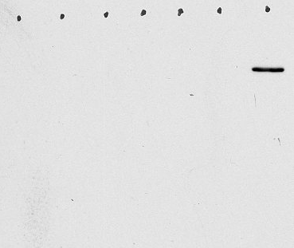
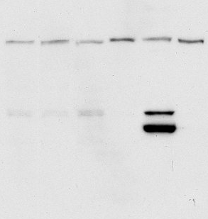
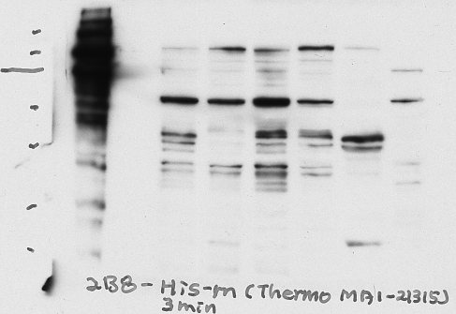
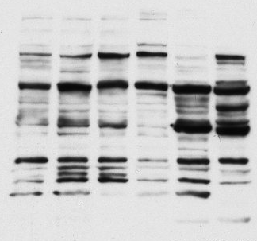
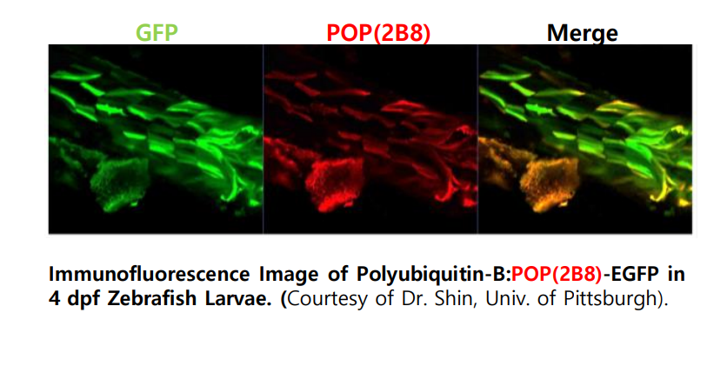
Anti-2B8 tag antibody (BJA-001)
(mouse monoclonal IgG, 100μg)
Contact : BioJane (www.biojane.net)
010-5381-4677, shbhoo@khu.ac.kr
BACKGROUND
2B8 epitope sequence (RDPLPFFPP, CGG GAC CCG TTG CCC TTT TTT CCA CCG) is the part of Deinococcus radiodurans Bacteriophytochromes (DrBphP). This monoclonal anti-2B8 antibody is highly specific to any protein containing minimal original epitope sequence (RDPLPFFPP). This antibody also react even better to a modified epitope sequence (RDPLPAFPP).
In case of C-terminal tagging, RDPLPFFPPS will show 100% binding to the 2B8 antibody.
Product research DATA
SOURCE
2B8 epitope is amino acid (3-11) sequence of Deinococcus radiodurans bacteriophytochrome (DrBphP, 75kDa). Anti-2B8 antibody was generated by immunizing purified DrBphP protein into mouse.
Specificity test of anti-2B8 antibody to total proteins of various organisms.
Coomassie blue staining(left) and Western blotting(right) analysis against various model organisms. 1: Rice; 2: Nicotiana benthamiana; 3: Arabidopsis thaliana; 4: Saccharomyces cerevisiae; 5: E.coli; 6: Dorosophila melanogaster S2; 7: Pre–B cell PD36; 8: purified DrBphP(control). Anti-2B8 antibody has no non-specific immune responses to total proteins of tested organisms.
PRODUCT
Each vial contains 100 μg IgG (monoclonal) in 200 μl of PBS with <0.1% sodium azide, 30% glycerol
* Control protein:
purified 2B8 tagged GFP protein (~28 kDa), use 5~10 μl
for western blot.
1 2 3 4 5 6 7
1 2 3 4 5 6 7
APPLICATIONS
Anti-2B8 antibody is recommended for detection of RDPLPFFPP or RDPLPAFPP peptide tagged fusion proteins by Western Blot, starting dilution with 1:5,000 (dilution range is 1:5,000~1:20,000), Immunoprecipition [~5 μg per 100-500 μg of total protein (1 ml of cell lysate)] and solid phase ELISA (starting dilution 1:1,000~1:10,000). Chromatine immunoprecipitation(ChIP)
Stain
α-2B8 Ab
1 2 3 4 5 6
1 2 3 4 5 6
1 2 3 4 5 6
STORAGE
Store at -20℃. Stable up to two year from the date of shipment. Non-hazardous. No MSDS required.
α-Myc (MMCRI)
α-His (Thermo)
α-Flag (Sigma)
SELECT PRODUCT CITAIONS
1. Choi HR, Kim TL, Cho MH, Bhoo SH (2017) Immuno-affinity purification of 2B8-tagged proteins. Appl. Biol. Chem. 60(5): 563-568.
2. Kim TL, Cho MH, Sangsawang K, Bhoo SH (2016) Fine Mutational Analysis of 2B8 and 3H7 Tag Epitopes with Corresponding Specific Monoclonal Antibodies. Mol Cells. 39(6): 460-467.
3. Kim TL, Yoo J, Sangsawang K, Cho MH, Yang SH, Suh JW, Hahn TR, Bhoo SH (2014) Epitope mapping of monoclonal antibodies for the Deinococcus radiodurans bacteriophytochome. Protein Sci. 23(6): 812-818.
Specificity test of anti-2B8 antibody to total proteins of various
human cell lines.
1. HEK-293(Human kidney) 2. HepG2(Human liver) 3. C33A(Human
cervix) 4. CRL-2302(Human eye) 5. Human-hepatocyte 6. Mouse-hepatocyte 7. 2B8-Sox9 expressed HEK-293 total protein
Anti-2B8 antibody has no non-specific immune responses to total proteins of tested human cell lines.

